Slide 1

: GenevaERS View Builder Training Course Module 1: Introduction to GenevaERS Views
Notes:
Welcome to the training course on , or GenevaERS. This is Module 1: Introduction to GenevaERS Views.

Slide 2
Module Objectives
Upon completion of this module, you should be able to:
Identify the two major software components of the GenevaERS product
Identify the major types of GenevaERS metadata
Navigate the GenevaERS Workbench
Create a simple view
Notes:
This module provides you with a broad overview of the GenevaERS product and the basics of its graphical user interface. By the end of this training, you should be able to:
Identify the two major software components of the GenevaERS product
Identify the major types of GenevaERS metadata
Navigate the GenevaERS Workbench, and
Create a simple view.

Slide 3

What Is GenevaERS?
GenevaERS is a software application development tool that solves high-volume data analysis and reporting problems.
GenevaERS provides capabilities for:
Data transformation
Data mining
Database query
Financial reporting
Notes:
GenevaERS is a software application development tool that solves high-volume data analysis and reporting problems. GenevaERS provides capabilities for data transformation, data mining, database query, and financial reporting.

Slide 4
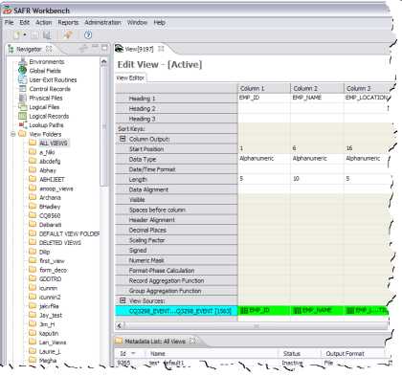
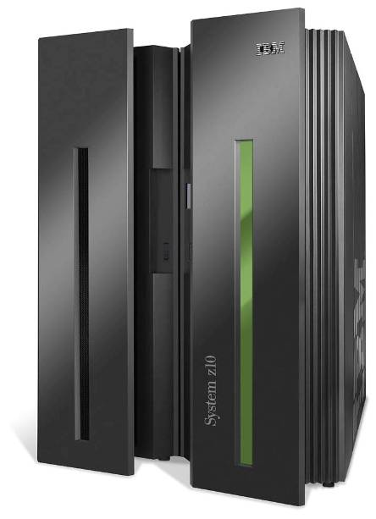
GenevaERS Components
GenevaERS
Metadata
Repository
Workbench (WB)
Source
Data
Output
Performance Engine (PE)
Notes:
GenevaERS consists of two software components: the PC-based Workbench and the mainframe-based batch process known as the Performance Engine. Developers use the Workbench to build applications that are stored in a metadata repository in an IBM® DB2® database. These applications are then run by the Performance Engine, which reads data from source files or databases, transforms it, and writes it to output files.

Slide 5
Metadata Types
Several types of metadata make up a GenevaERS application. The most common types are:
Environment definition
Physical file definition (PF)
Logical file definition (LF)
Logical record definition (LR)
View definition
View folder
Note: When discussing metadata, we often omit the word “definition” because it is usually clear from the context whether we mean the metadata or the entity it refers to.
Notes:
Several types of metadata make up a GenevaERS application. The most common are the environment definition, the physical file definition (or PF), the logical file definition (or LF), the logical record definition (or LR), the view definition, and the view folder.
Note that, when discussing GenevaERS metadata, we often omit the word “definition” because it is usually clear from the context whether we mean the metadata or the entity it refers to.

Slide 6
Metadata: Environment
An environment definition describes a logical collection of metadata within the GenevaERS Workbench.
Production
Training
Development
Notes:
An environment definition describes a logical collection of metadata within the GenevaERS Workbench. Typical types of environments include development, production, or training environments. Access to an environment can be restricted to a certain set of users.

Slide 7
Metadata: PF, LF, and LR
Physical File (PF)
Logical File (LF)
Logical Record (LR)
CUSTOMER
CUSTOMER
CUSTOMER
ORDER_001
ORDER_002
ORDER_001
ORDER_003
ORDER
ORDER_ALL
ORDER_004
ORDER_005
Notes:
A physical file definition, or PF, describes a data source. Examples include customer or order files. A logical file definition, or LF, describes a collection of one or more physical files. A logical record definition, or LR, describes a record layout. In COBOL programs, record layouts are often found in copybooks. In relational databases, they are found in table definitions.
Some examples of these metadata types are shown here.
A logical record for a customer is used to map data to a customer logical file. The customer logical file refers to data in a customer physical file.
An order logical record is used to map data from a logical file named ORDER_001, which refers to data in a single physical file named ORDER_001.
The order logical record can also be used to map data from a logical file named ORDER_ALL. ORDER ALL refers to a collection of order physical files.

Slide 8
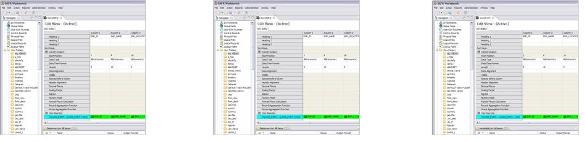
Metadata: Views and View Folders
View 1
View 2
View 3
Bob’s Views
Notes:
A view definition describes a data transformation. It is analogous to a program or a query. Views are the basic units of work that are performed by the Performance Engine.
Views are often grouped together into view folders for ease of maintenance. View folders are often named for a particular developer or function. Security can be applied to view folders to prevent unauthorized access.

Slide 9
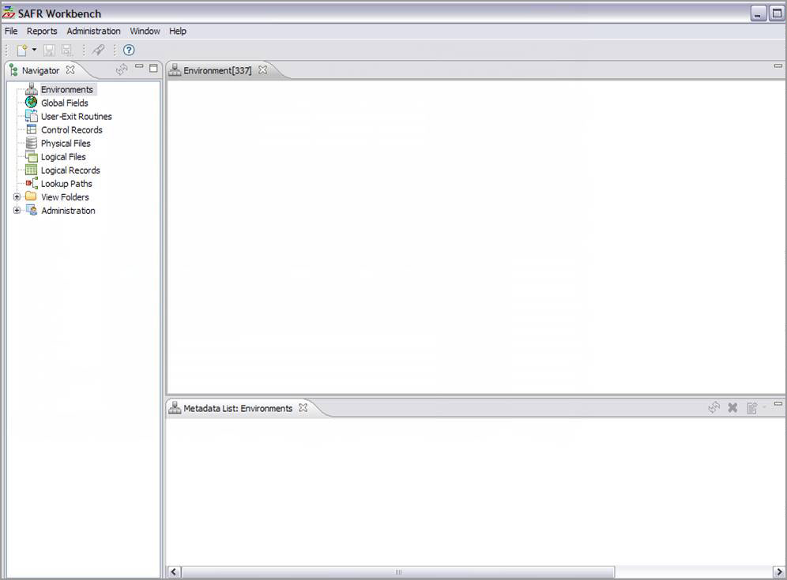
GenevaERS Workbench Examples
Menus
Toolbar
Editor Area
Navigator
Area
Metadata List Area
Notes:
The GenevaERS Workbench is used to add, change, and delete GenevaERS metadata. It contains a menu and toolbar, and consists of multiple display areas, or frames.
The Navigator area displays the types of metadata available.
The Metadata List area displays a list of items for the selected metadata type.
And the Editor area is the part of the screen where you modify metadata items.

Slide 10
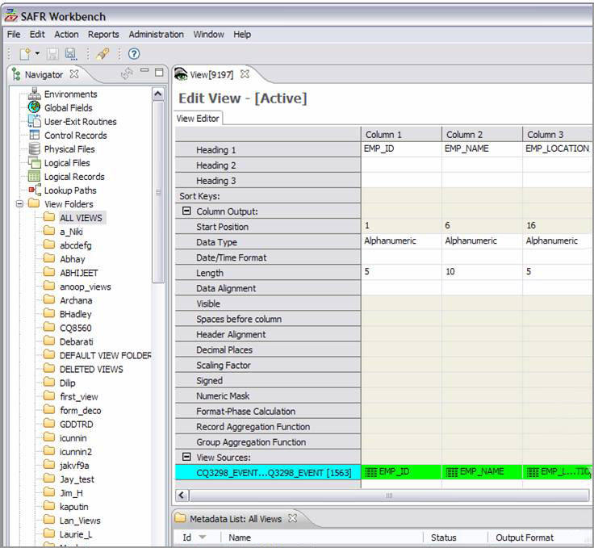
Views and View Folders
GenevaERS View
GenevaERS View Folders
Notes:
By expanding the View Folders item in the Navigator area, you can see a list of all view folders.
The contents of the selected folder are displayed in the Metadata List area.
From there, you can select a view for editing and the view will be displayed in the Editor area.

Slide 11
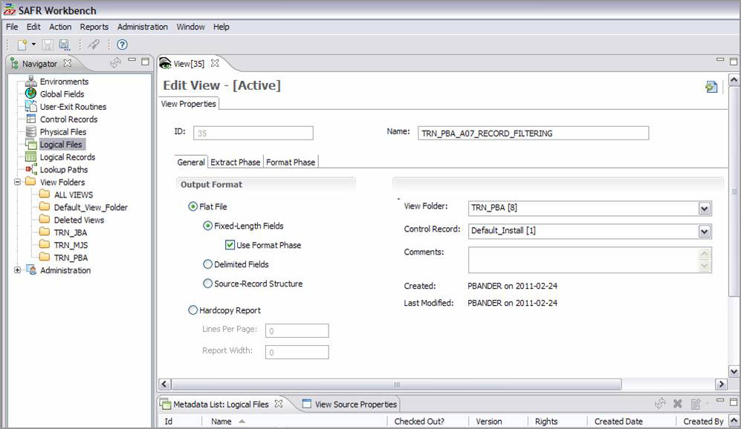
View Properties Screen
Notes:
View information is displayed on two separate screens:
The View Editor screen, where you can define specific data transformations.
The View Properties screen, where you can modify information that applies to the whole view.

Slide 12
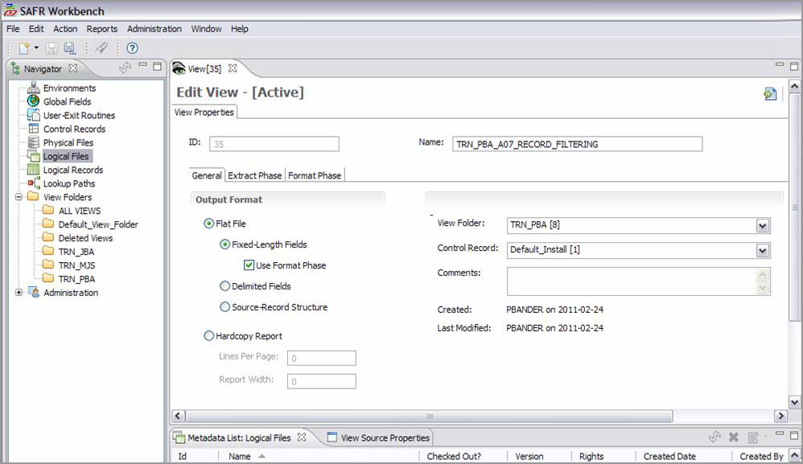
Output File Format Information
Output File Format Information
Creator and Last Modifier of View
Notes:
You use the General tab on the View Properties screen to specify the output format – flat file or hardcopy report – and other related information.
This tab also displays information about when the view was created and last modified and by whom.

Slide 13
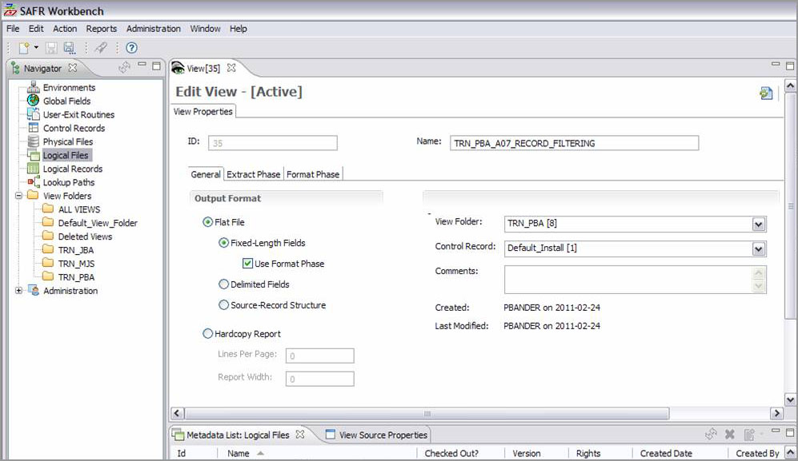
View Folder Information
The View Folder field identifies the location where the view is stored.
Notes:
In addition, the General tab displays the name of the view folder where the view is stored.

Slide 14

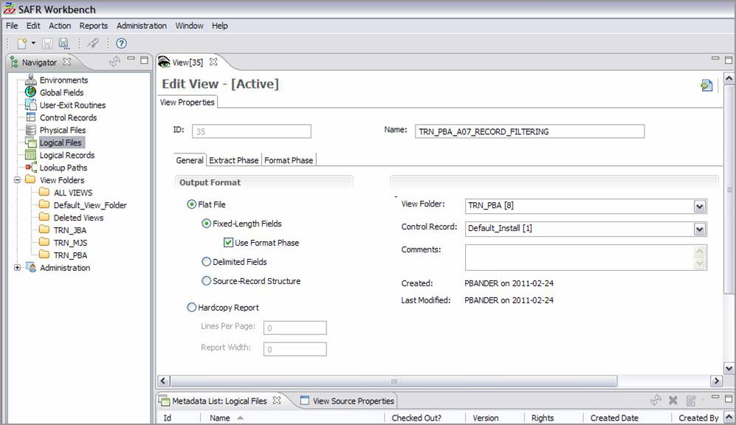
Additional Properties Tab
Open the Extract Phase tab or the Format Phase tab by clicking it.
Notes:
You can access advanced features on the Extract Phase tab and the Format Phase tab. You can open these tabs by single-clicking them.

Slide 15

Toggling Between View Screen
Toggle between the View Properties screen and the View Editor screen by clicking the Show Grid/Properties toolbar icon, or by pressing the F9 key.
Notes:
You can toggle back and forth between the View Properties screen and the View Editor screen by clicking the first icon in the Editor area toolbar, or by pressing the F9 key.

Slide 16
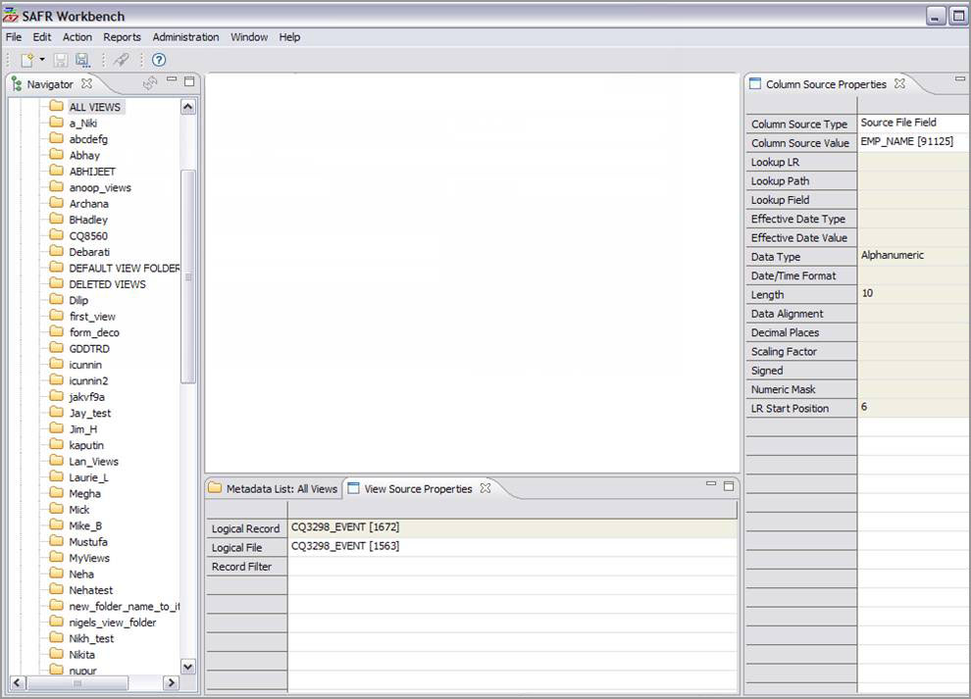
View Editor Screen
Notes:
In View Editor mode, the Workbench displays several frames of view information.

Slide 17
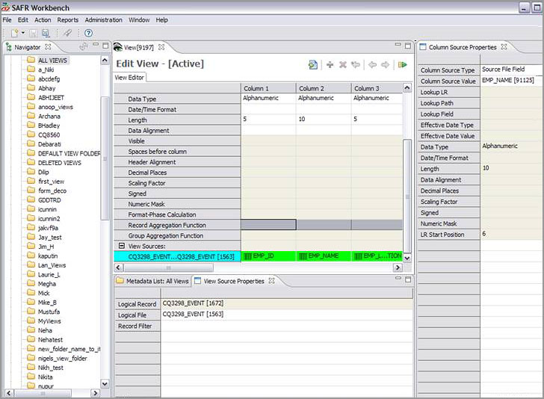
View Column Output
View Editor Grid
View Output Columns
View
Output Information
Notes:
The View Editor grid displays the characteristics of view output columns. These characteristics include the data type, the length, and the alignment, such as left, right, or center.

Slide 18
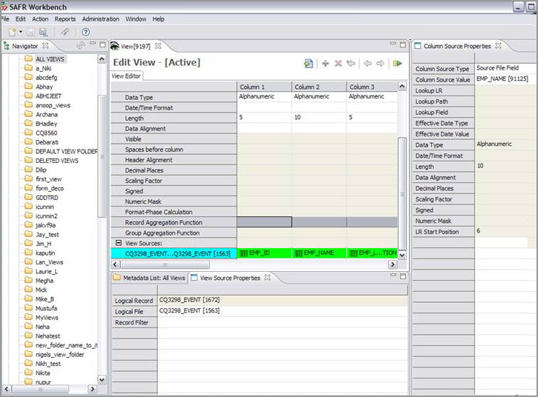
View Source Properties
Open the
View
Source Properties tab by right-clicking a blue cell.
View
Source
Properties
Notes:
You can display information about the data source for the view by right-clicking a blue cell in the View Editor grid. This information includes the logical record and the logical file.

Slide 19

View Column Properties
Open the Column Source Properties tab by right-clicking a green cell.
Column
Source
Properties
Notes:
To open a frame showing the column source properties, you right-click a green cell. The source of a column’s data can be a field in the source file, a constant, a lookup value, or the result of a formula.

Slide 20
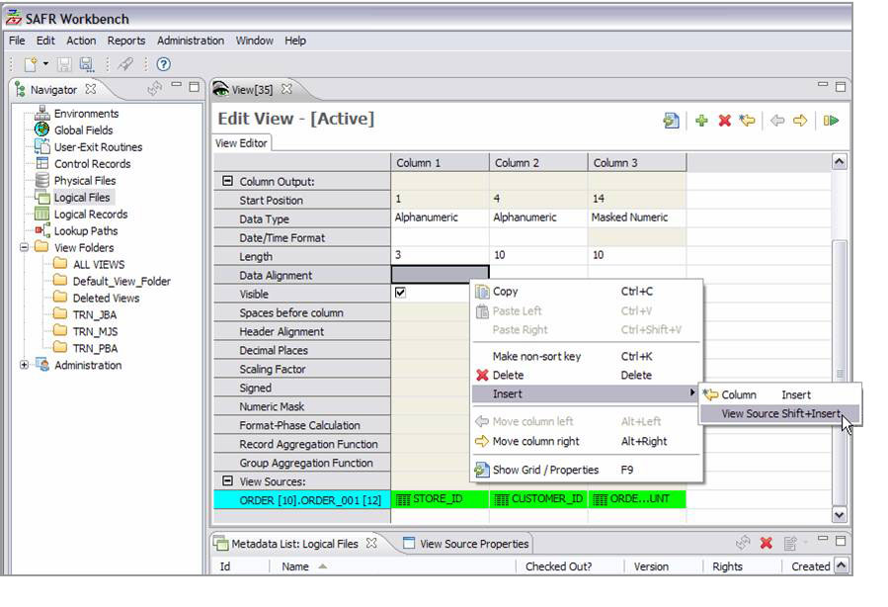
View Editor Functions
You can select a View Editor function from the Edit menu or the Action menu.
OR you can single-click any View Editor toolbar icon to perform the function.
OR you can right- click in the grid and select the function from the menu.
OR you can press the appropriate keyboard combination.
Notes:
The View Editor incorporates several functions, such as inserting a column or activating a view. You can run a View Editor function in several ways:
Select it from the Edit menu or the Action menu for the Workbench
Left-click the function icon on the View Editor toolbar
Right-click in the View Editor grid and select the function from the pop-up menu
Or press the appropriate key combination, which is noted on the Workbench menu and the pop-up menu.
Choose whichever technique you prefer.

Slide 21
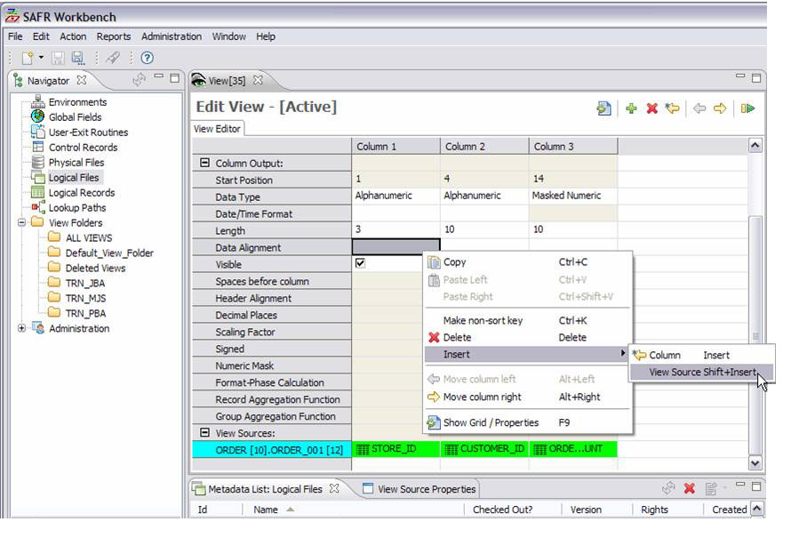

Adding a New Source (1 of 2)
To add a source file (dashed line), open the Insert View Source window (below) by right-clicking any cell in the View Editor grid, and then click Insert -> View Source on the menu.
Notes:
To add a new view source, you right-click on the grid to display the pop-up menu, and then select Insert and View Source.

Slide 22

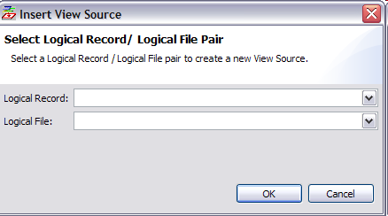
Adding a New Source (2 of 2)
Notes:
The Insert View Source window opens. You can select from a list of data sources in the window.

Slide 23
Simple Data Transformation View
ORDER001
Program
OUTPUT
From the ORDER001 file, select the ORDER-ID, CUSTOMER-ID,
and TOTAL-AMOUNT fields.
Notes:
Now let’s take what you’ve learned and create your own view. The following example is a simple data transformation, reading data from the ORDER001 file and writing out only the Order ID, Customer ID, and Total Amount fields.

Slide 24
Coding with Conventional Programming
ORDER001
Program
OUTPUT
From the ORDER001 file, select the ORDER-ID, CUSTOMER-ID,
and TOTAL-AMOUNT fields.
Conventional Programming
Define files
Define records
Code business logic
Compile program
Link program
Run program
Notes:
If we were to code a conventional program, we would:
Define the file attributes
Define the record layouts
Code the business logic
Compile the program
Link the program and
Run the program

Slide 25
Coding with the GenevaERS Tool (1 of 2)
ORDER001
Program
OUTPUT
From the ORDER001 file, select the ORDER-ID, CUSTOMER-ID,
and TOTAL-AMOUNT fields.
GenevaERS Tool
WorkBench (WB)
Performance Engine (PE)
Conventional Programming
Define files
Define records
Code business logic
Compile program
Link program
Run program
GenevaERS Tool
WorkBench (WB)
Performance Engine (PE)
GenevaERS Tool
WorkBench (WB)
Performance Engine (PE)
Notes:
With the GenevaERS tool, the first three steps are performed in the Workbench and the last three are performed for you by the Performance Engine.

Slide 26
Coding with the GenevaERS Tool (2 of 2)
ORDER001
Program
OUTPUT
Covered in the “Creating Metadata” training module
From the ORDER001 file, select the ORDER-ID, CUSTOMER-ID,
and TOTAL-AMOUNT fields.
GenevaERS Tool
WorkBench (WB)
Performance Engine (PE)
Conventional Programming
Define files
Define records
Code business logic
Compile program
Link program
Run program
GenevaERS Tool
WorkBench (WB)
Performance Engine (PE)
GenevaERS Tool
WorkBench (WB)
Performance Engine (PE)
Covered in the following slides
Covered in the “Performance Engine Overview” training module
Notes:
Defining files and records will be covered in the GenevaERS training module entitled “Creating Metadata.” The Performance Engine will be introduced in the “Performance Engine Overview” module. The topic of coding business logic will be introduced in the next few slides.

Slide 27
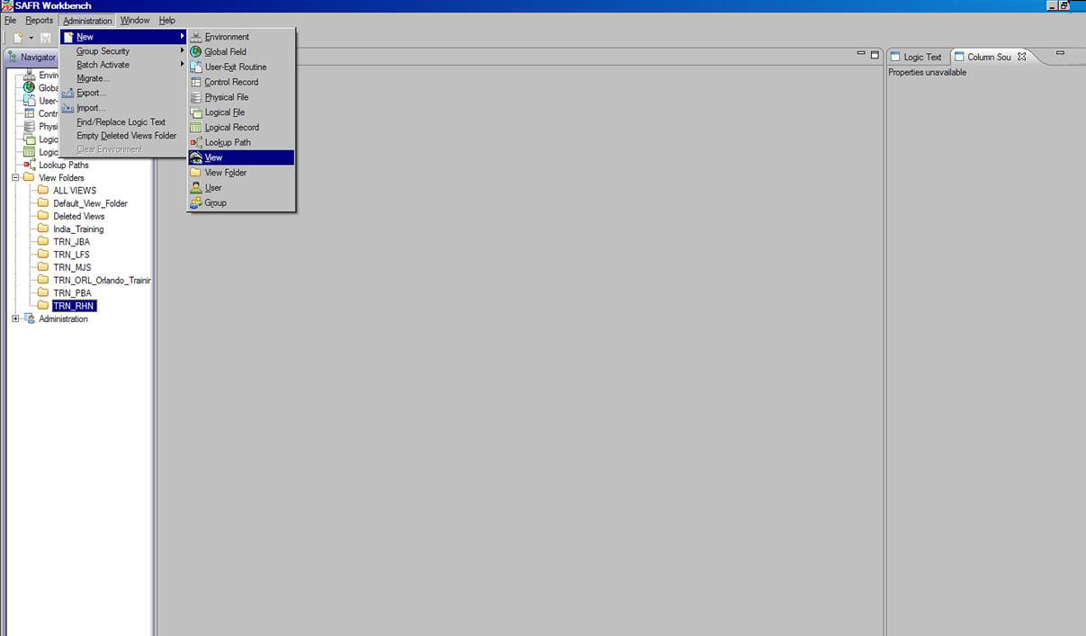
Creating a New View (1 of 2)
Notes:
In the example described in the following slides, metadata has been pre-populated in the Workbench for ease of instruction.
To create a new view, click the Administration menu, select New and then select View.

Slide 28
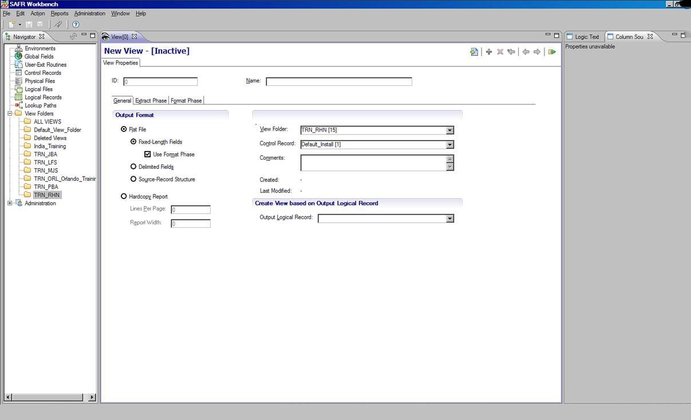
Creating a New View (2 of 2)
Notes:
The View Properties tab opens.

Slide 29
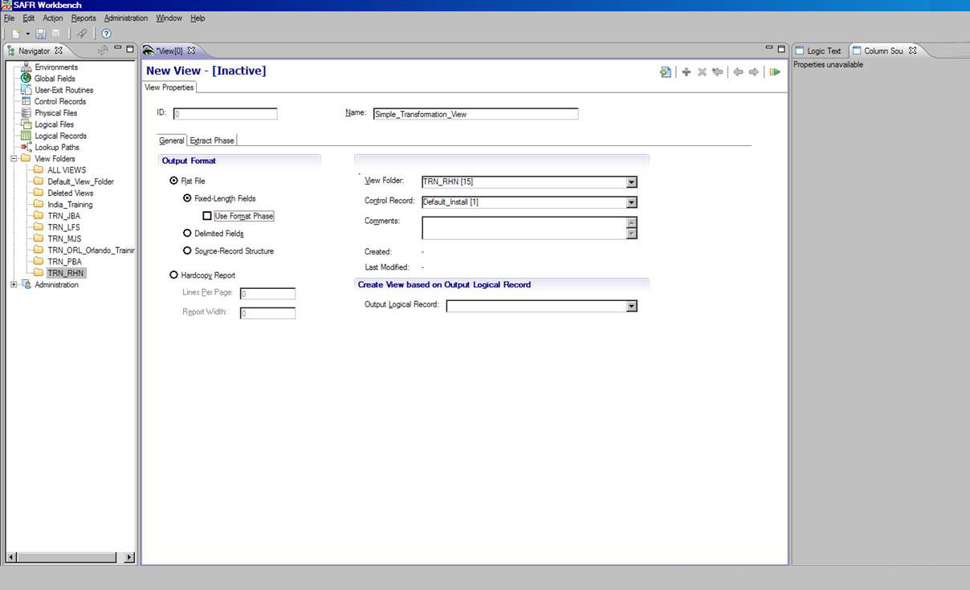
Entering the View Name
View Name field
Format Phase check box
Notes:
Enter a descriptive name for the view, such as “Simple_Transformation_View.” Note that embedded spaces are not allowed in names, so you must use underscores to separate words. Next, clear the Format Phase check box; this feature is not needed for this simple view.

Slide 30
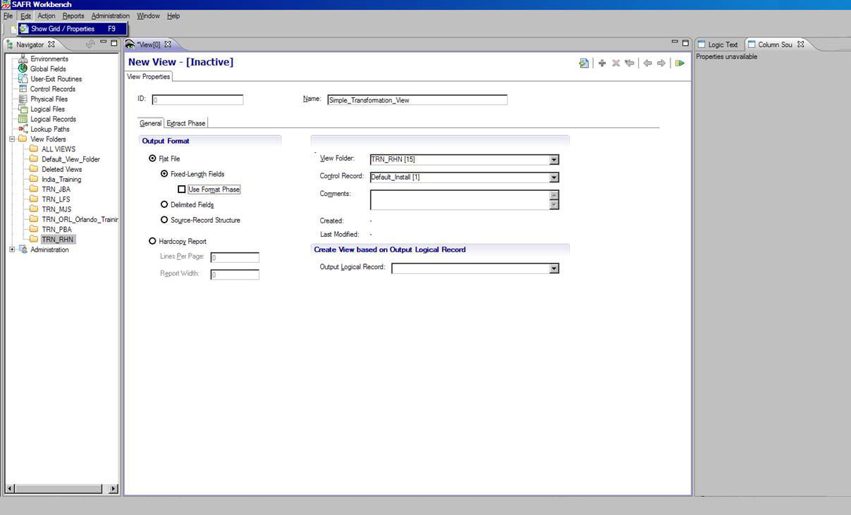
Switching to the View Editor Grid
The Show Grid/Properties selection on the Edit menu
Notes:
To display the View Editor Grid, select Show Grid or Properties, from the Edit menu (Alternatively, you can click the toolbar icon or press the F9 key).

Slide 31
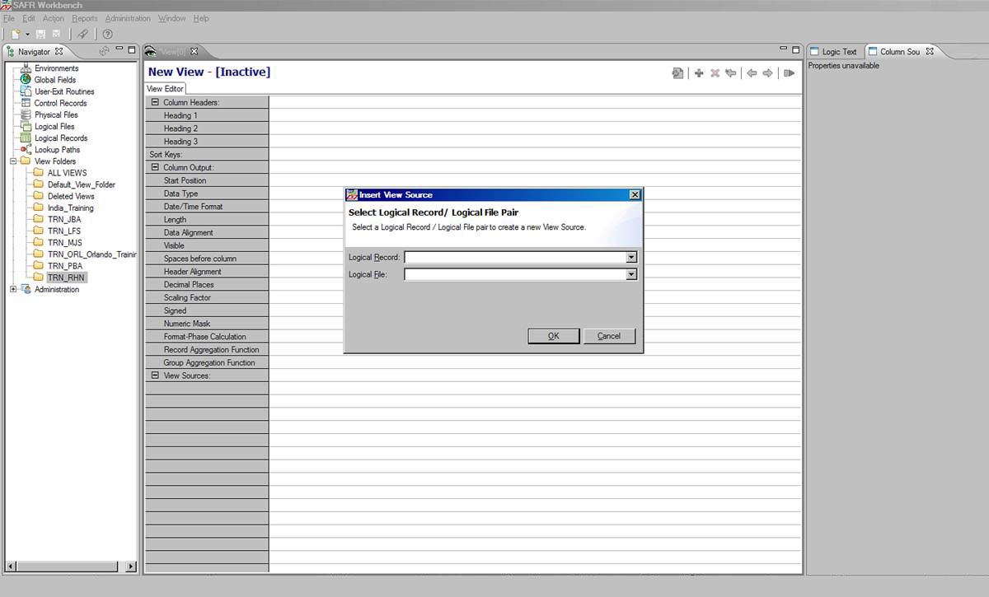
Adding a View Source (1 of 2)
Notes:
From the Edit menu, select Insert, and then select View Source (Alternatively, you can right-click and select Insert and then select View Source from the pop-up menu, or you can press the Shift key and the Insert key). The Insert View Source window opens.

Slide 32
Adding a View Source (2 of 2)
Logical Record List
Logical File List
Notes:
From the Logical Record list, select ORDER. Then, from the Logical File list, select ORDER_001.

Slide 33
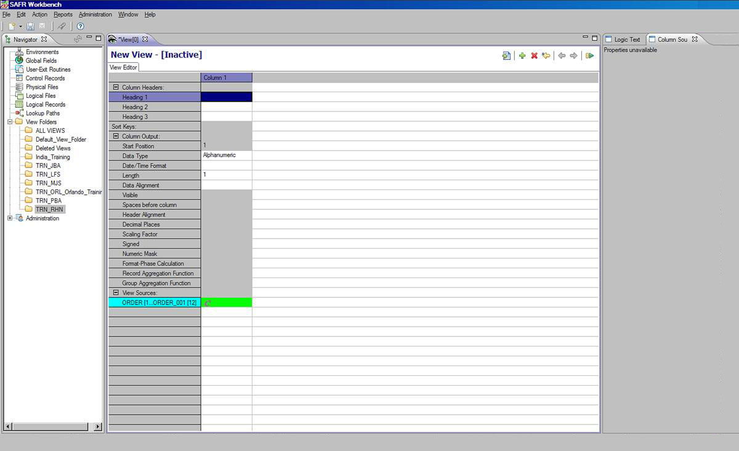
Adding a Column
Notes:
From the Edit menu, select Add Column (Alternatively, you can click the plus sign icon on the toolbar or press Alt and the Insert key). A new column is added to the grid.

Slide 34
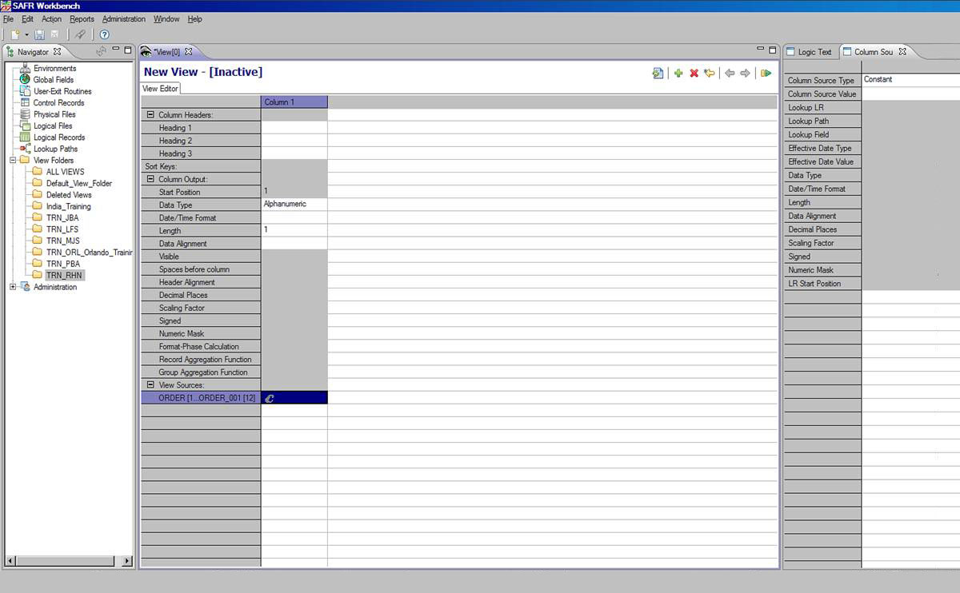
Displaying the Column Source Properties
Column Source cell (normally green, highlighted in blue here)
Column Source Properties frame
Notes:
Click the green cell. The Column Source Properties frame opens on the right.

Slide 35
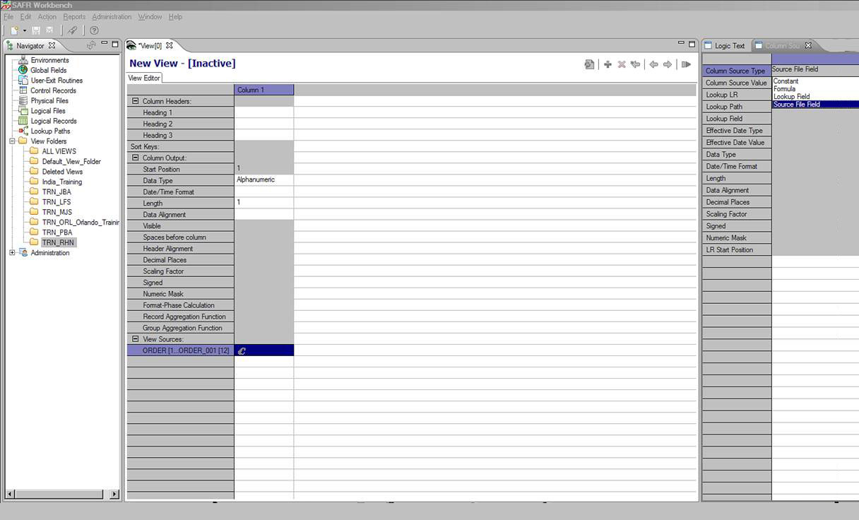
Selecting the Column Source Type
Column Source Type list box
Notes:
In the Column Source Type field, click the list box and select Source File Field.

Slide 36
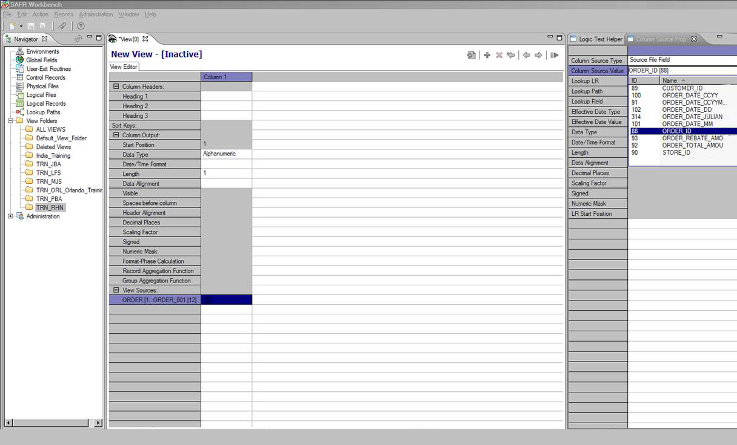
Selecting the Column Source Value
Column Source Value list box
Notes:
In the Column Source Value field, click the list box and select ORDER_ID.

Slide 37
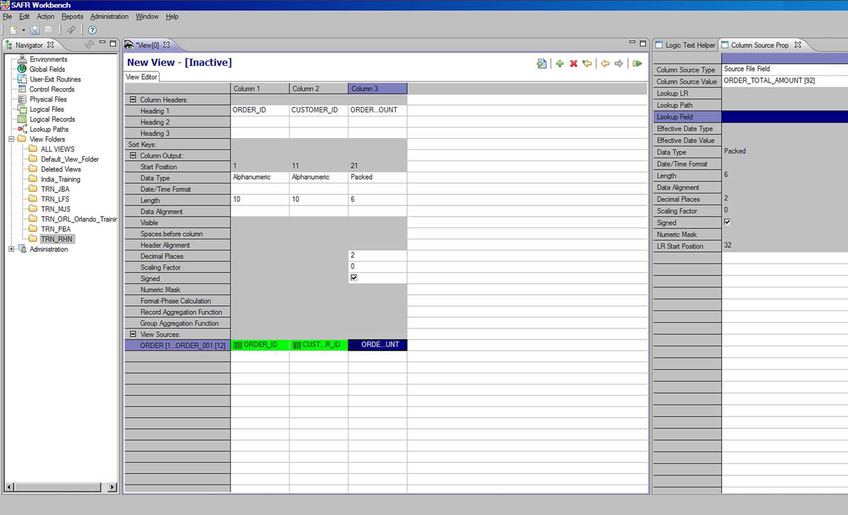
Adding Columns
Save icon (diskette symbol)
New columns
Notes:
Repeat the previous steps to add columns for Customer ID and Order Total Amount. Then save the view by selecting Save from the File menu, or by clicking the Save icon in the Workbench toolbar, or by pressing Control and S.

Slide 38

Activating the View
Active status indicator
Activate icon
Notes:
To activate the view, use any of these methods:
Select Activate from the Action menu
Press the Activate icon on the View Editor toolbar
Press F5.
The view title bar now displays the word “active”. Save the view again to preserve this active state. The view is now ready to be run.

Slide 39
Module Summary
Now that you have completed this module, you should be able to:
Identify the two major software components of the GenevaERS product
Identify the major types of GenevaERS metadata
Navigate the GenevaERS Workbench
Create a simple view
Notes:
© Copyright IBM Corp. 2012, licensed under Apache 2.0 to the GenevaERS project
This module provided an overview of GenevaERS. Now that you have completed this module, you should be able to:
Identify the two major software components of the GenevaERS product
Identify the major types of GenevaERS metadata
Navigate the GenevaERS Workbench and
Create a simple view

Slide 40

For Additional Information
The following table provides additional support and/or reference material for GenevaERS.
Screen Title | Web Address
GenevaERS Information Center | http://GenevaERS.ibm.com/help/index.jsp
GenevaERS Solution Screen | http://www.ibm.com/systems/GenevaERS
Exploiting IBM GenevaERS to Solve Financial Accounting Challenges | http://www.redbooks.ibm.com/abstracts/redp4599.html?Open
Notes:
© Copyright IBM Corp. 2012, licensed under Apache 2.0 to the GenevaERS project
Additional information about GenevaERS is available at the web addresses shown here.

Slide 41
Trademarks
IBM, the IBM logo, and ibm.com are trademarks or registered trademarks of International Business Machines Corporation in the United States, other countries, or both. If these and other IBM trademarked terms are marked on their first occurrence in this information with a trademark symbol (® or ™), these symbols indicate U.S. registered or common law trademarks owned by IBM at the time this information was published. Such trademarks may also be registered or common law trademarks in other countries. A current list of IBM trademarks is available on the web at http://www.ibm.com/legal/copytrade.shtml.
Other company, product, or service names may be trademarks or service marks of others.
Notes:
This page does not have audio.

Slide 42

Thank You
Notes:
This concludes the Module 1. Thank you for your participation.

